Slide 1
What Is the State of Food Security and Nutrition in the United States?
Jawaid Hakim
Food Security: Access by all people at all times to enough food for an active healthy life

Slide 2
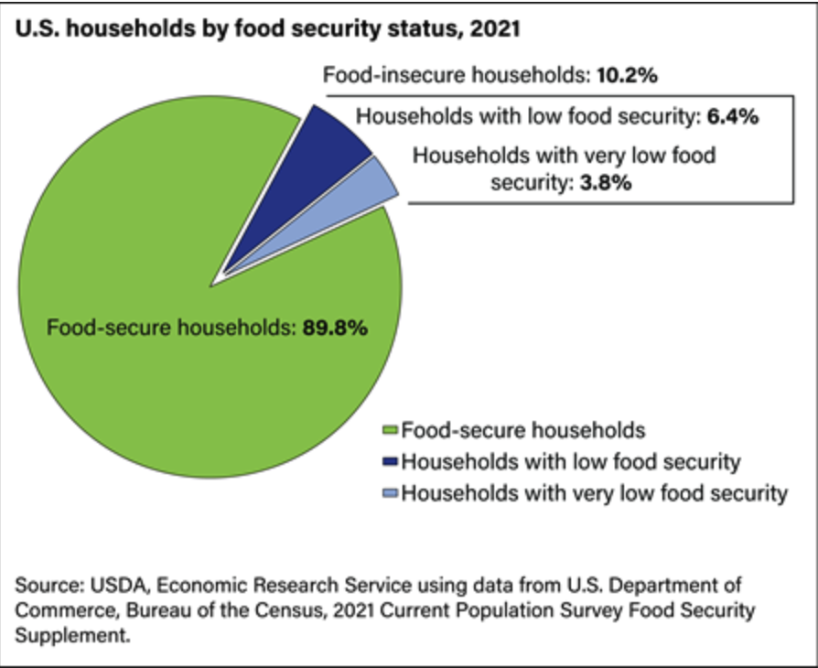
Food Security Status for U.S. Households, 2021
Food Insecure: At times during the year, these households were uncertain of having or unable to acquire enough food to meet the needs of all their members because they had insufficient money or other resources for food. Food-insecure households include those with low food security and very low food security.
Low food security: These food-insecure households obtained enough food to avoid substantially disrupting their eating patterns or reducing food intake by using a variety of coping strategies, such as eating less varied diets, participating in Federal food assistance programs, or getting food from community food pantries.
Very low food security—In these food-insecure households, normal eating patterns of one or more household members were disrupted and food intake was reduced at times during the year because they had insufficient money or other resources for food.

Slide 3
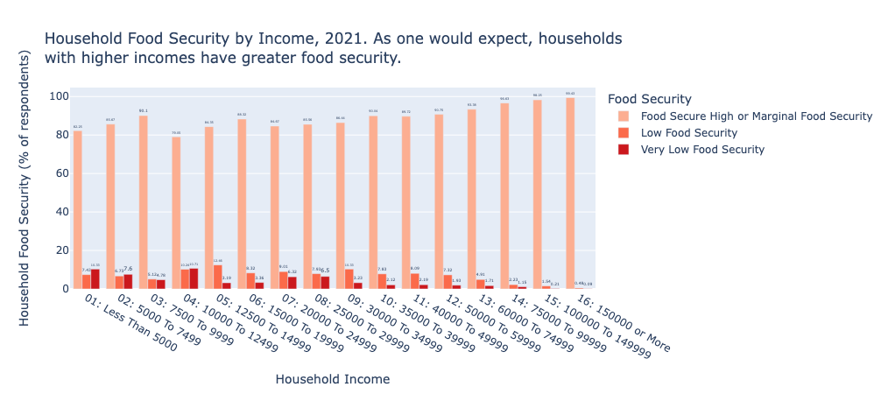
Household Food Security by Income, 2021

Slide 4
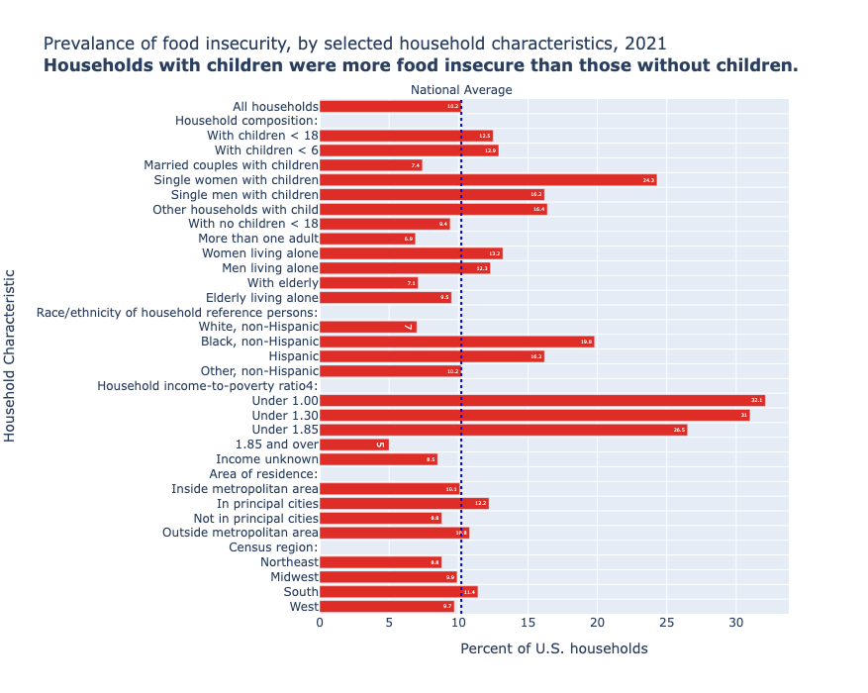
Households with Children in 2021
The prevalence of food insecurity varied considerably among household types. Rates of food insecurity were higher than the national average (10.2 percent) for the following groups:
All households with children (12.5 percent).
Households with children under age 6 (12.9 percent).
Households with children headed by a single woman (24.3 percent) or a single man (16.2 percent).
Women living alone (13.2 percent) and men living alone (12.3 percent).
Households with Black, non-Hispanic (19.8 percent) and Hispanic reference persons (16.2 percent; a household reference person is an adult household member in whose name the housing unit is owned or rented).

Slide 5
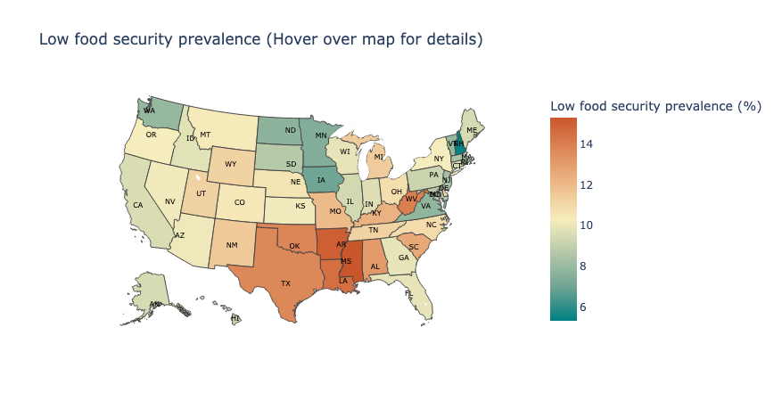
Low Food Security Prevalence, 2021
Mississippi | 15.3%
Arkansas | 15.0%
Louisiana | 14.5%
West Virginia | 14.0%
Oklahoma | 13.8%
… | …
Virginia | 7.8%
North Dakota | 7.7%
Minnesota | 7.4%
Iowa | 7.0%
New Hampshire | 5.4%

Slide 6
Food Insecurity and Adverse Health Outcomes for Children
Numerous research studies have shown that food insecurity is related to significantly worse general health, some acute and chronic.
Compared to rates had they not been food insecure, children in food-insecure household had rates of lifetime asthma diagnosis and depressive symptoms that were 19.1% and 27.9% higher, rates of foregone medical care that were 179.8% higher, and rates of emergency department use that were 25.9% higher.

Slide 7
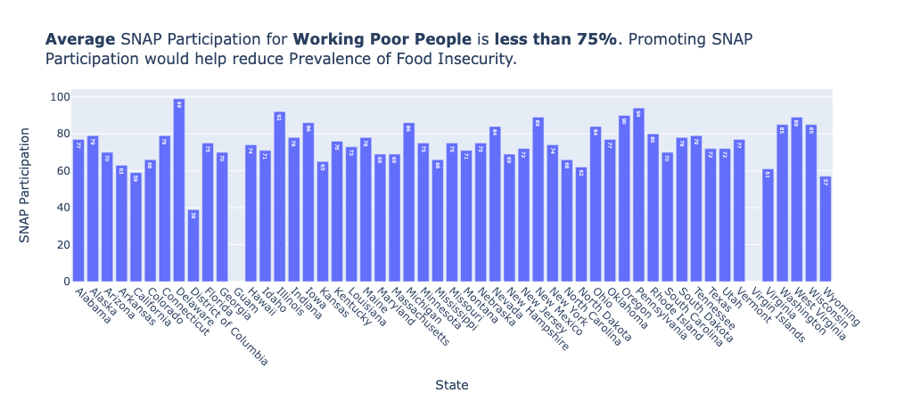
Increasing Food Security for Children

Slide 8
Increasing Food Security for Children
Policies used to reduce household food insecurity among children may also reduce children’s chronic and acute health problems and health care needs.
National School Lunch Program (NSLP) provides nutritionally balanced, low-cost or free lunches to children each day. Increased funding for NSLP can have a direct and meaningful impact on food security for children who attend public and nonprofit private schools and residential child care institutions.
Increased funding and encouraging participation in SNAP (Supplemental Nutrition Assistance Program) through outreach and awareness education can positively impact health outcomes for low income families by reducing food insecurity.

Slide 9
Data Sources
SNAP Participation: https://www.fns.usda.gov/usamap#
Food Security Status of U.S. Households in 2021: https://www.ers.usda.gov/topics/food-nutrition-assistance/food-security-in-the-u-s/key-statistics-graphics/#children
Food Security and Child Health: https://pubmed.ncbi.nlm.nih.gov/31501236

